Slide 1
Routing

Slide 2
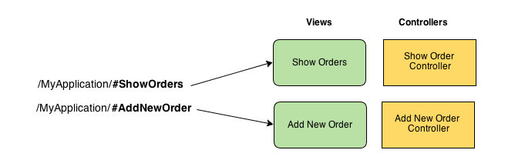
Routing helps you in dividing your application in logical views and bind different views to Controllers.

Slide 3
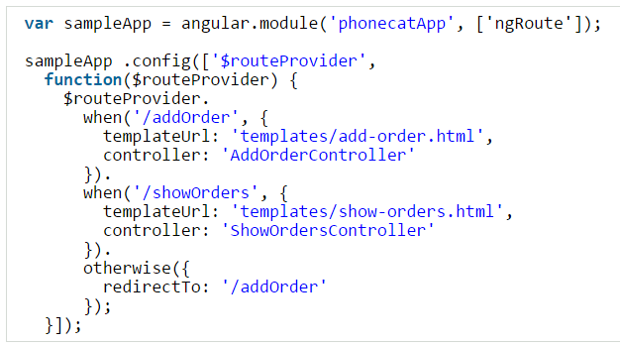
Introduction to $routeProvider
Application routes in Angular are declared via the $routeProvider, which is the provider of the $route service. This service makes it easy to wire together controllers, view templates, and the current URL location in the browser. Using this feature we can implement deep linking, which lets us utilize the browser’s history (back and forward navigation) and bookmarks.
Syntax to add Routing
Once we have our app, we can useconfig() method to configure $routeProvider. $routeProvider provides method .when() and.otherwise() which we can use to define the routing for our app.

Slide 4
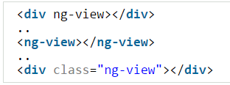
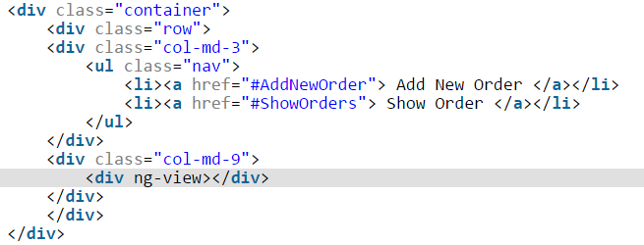
ng-view
One thing worth noting is the ng-view directive. In our angular app, we need to define ng-view directive once. This becomes the placeholder for views. Each view referred by the route is loaded in this section of document.
You can define ng-view in main html file in one of the below way.
-------------------------------------------------------------------------------------------------------------------

Slide 5
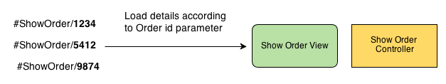
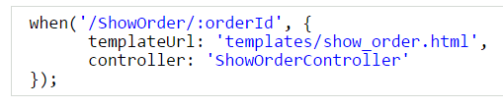

2. How to pass Parameters in Route Urls
Consider below scenario. We want to display details of different orders. Based on a parameter order_id we will define order details in view.
In angular while define route we can define parameters using orderId in url. For example:
And we can read the parameter in Controller by using $routeParams.orderId.

Slide 6
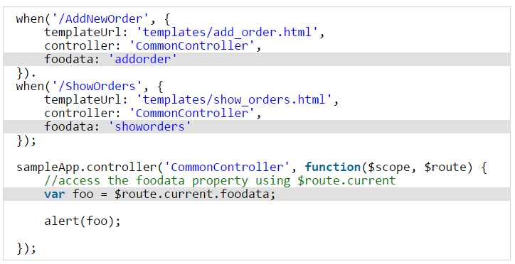
3. Add Custom Data to RouteProvider
The $routeProvider provides methods when() and otherwise() which we used to define url routes. Sometime we might want to pass custom data based on certain route. For example you might use same Controller in different routes and use some custom data. For example:

Slide 7
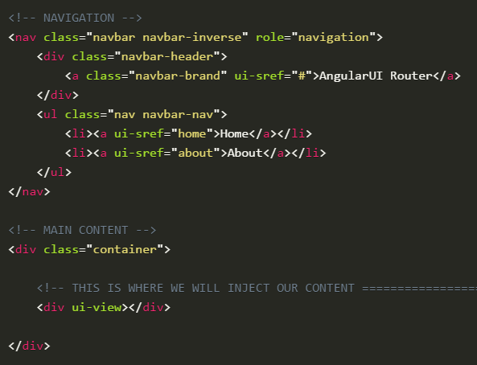
What is AngularUI Router?
The UI-Router is a routing framework for AngularJS built by the AngularUI team. It provides a different approach than ngRoute in that it changes your application views based on state of the application and not just the route URL.
States vs URL Route
With this approach, your views and routes aren’t tied down to the site URL. This way, you can change the parts of your site using your routing even if the URL does not change.
When using ngRoute, you’d have to use ngInclude or ng-view and this could get confusing. Now that all of your states, routing, and views are handled in your one .config(), this would help when using a top-down view of your application.

Slide 8
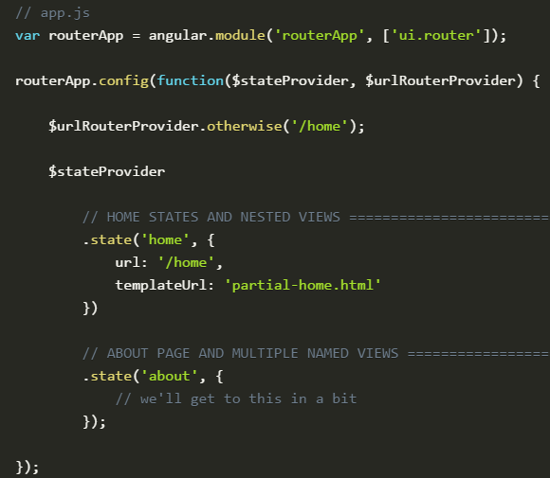
When creating a link with UI-Router, you will use ui-sref. The href will be generated from this and you want this to point to a certain state of your application. These are created in your app.js.
We also use <div ui-view></div> instead of ngRoute’s <div ng-view></div>.

Slide 9
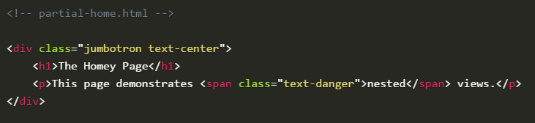
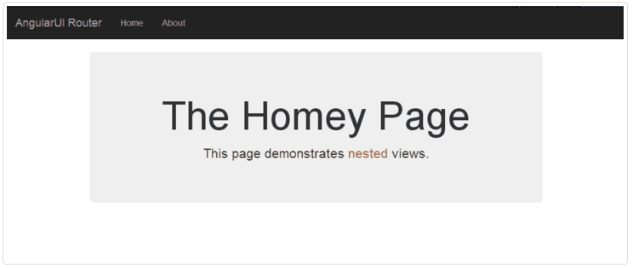
Now we have created the routerApp that we already applied to our body in theindex.html file.
Here we have a .state() for home and for about. In home, we are using the template file partial-home.html.
Let’s fill out our partial-home.html page so we can actually see information.

Slide 10
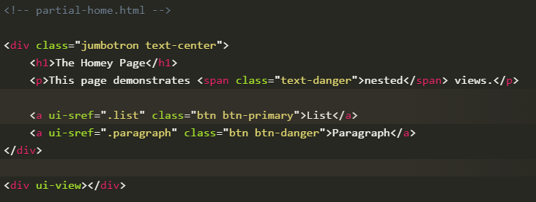
Nested Views
When linking to a nested view, we are going to use dot denotation:
ui-sref=".list" and ui-sref=".paragraph".
These will be defined in our Angular file and once we set it up there, we will inject into our new <div ui-view></div>.

Slide 11
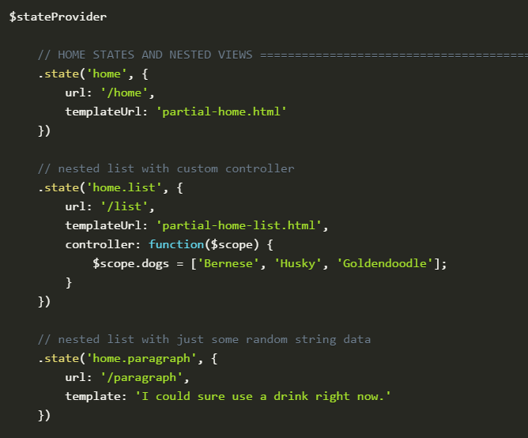
In our app.js file, let’s create those nested states.

Slide 12
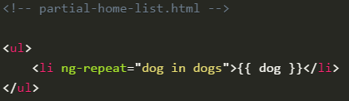
Now the ui-sref we defined in home.html are linked to an actual state. Withhome.list and home.paragraph created, those links will now take the template provided and inject it into ui-view.

Slide 13
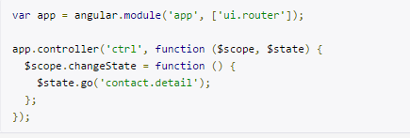
Manually moving to other states
$state.go(to, params)
While configuring states
.state(‘stateName’,{
templateUrl:’url’,
controller:’controllerName’,
params:{parName:null}
})
Using in your controller
$scope.abc=$state.params.parName;
Sending values from controller to other controller
$state.go(‘stateName’,{parName:’Rohan’})

Slide 14
$state.go(to, params, options)
Convenience method for transitioning to a new state. $state.go calls $state.transitionTo internally but automatically sets options to{ location: true, inherit: true, relative: $state.$current, notify: true }. This allows you to easily use an absolute or relative to path and specify only the parameters you'd like to update (while letting unspecified parameters inherit from the currently active ancestor states).
Parameters:
to: (String): Absolute state name or relative state path.
$state.go('contact.detail') - will go to the contact.detail state
$state.go('^') - will go to a parent state
$state.go('^.sibling') - will go to a sibling state
$state.go('.child.grandchild') - will go to grandchild state
Params [Object] : A map of the parameters that will be sent to the state, will populate $stateParams. Any parameters that are not specified will be inherited from currently defined parameters. Only parameters specified in the state definition can be overridden, new parameters will be ignored.
Options[Object]:
location - {boolean=true|string=} - If true will update the url in the location bar, if false will not. If string, must be "replace", which will update url and also replace last history record.
inherit - {boolean=true}, If true will inherit url parameters from current url.
relative - {object=$state.$current}, When transitioning with relative path (e.g '^'), defines which state to be relative from.
notify - {boolean=true}, If true will broadcast $stateChangeStart and $stateChangeSuccess events.
reload (v0.2.5) - {boolean=false}, If true will force transition even if no state or params have changed. It will reload the resolves and views of the current state and parent states.

Slide 15
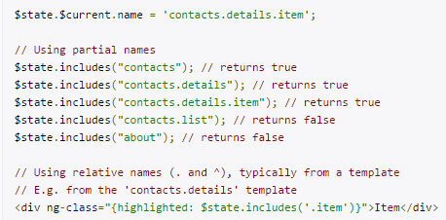
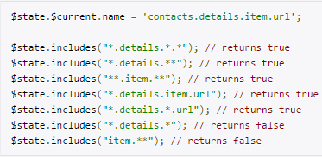
$state. includes(stateOrName, params)
A method to determine if the current active state is equal to or is the child of the state stateName. If any params are passed then they will be tested for a match as well. Not all the parameters need to be passed, just the ones you'd like to test for equality.
Parameters
stateOrName(String): A partial name, relative name, or glob pattern to be searched for within the current state name.
params[Object]: A param object, e.g. {sectionId: section.id}, that you'd like to test against the current active state.
Returns true if it does include the state
Examples

Slide 16
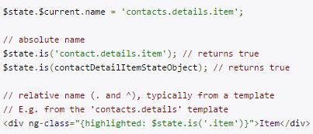
$state.is(stateOrName, params)
Similar to $state.includes, but only checks for the full state name. If params is supplied then it will be tested for strict equality against the current active params object, so all params must match with none missing and no extras.
Returns true if it is the state.

Slide 17
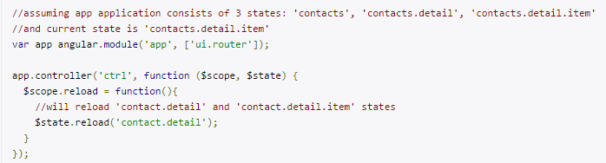
$state.reload(state)
A method that force reloads the current state. All resolves are re-resolved, controllers reinstantiated, and events re-fired.
reload() is just an alias for:
$state.transitionTo($state.current, $stateParams, { reload: true, inherit: false, notify: true});

Slide 18
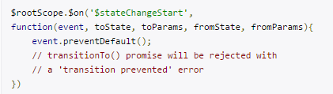
Events of $state
$stateChangeError : Fired when an error occurs during transition. It's important to note that if you have any errors in your resolve functions (javascript errors, non-existent services, etc) they will not throw traditionally. You must listen for this $stateChangeError event to catch ALL errors.
$stateChangeStart: Fired when the state transition begins. You can use event.preventDefault() to prevent the transition from happening and then the transition promise will be rejected with a 'transition prevented' value.
$stateChangeSuccess: Fired once the state transition is complete.
$stateNotFound: Fired when a requested state cannot be found using the provided state name during transition.

